Slide 1
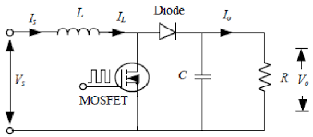
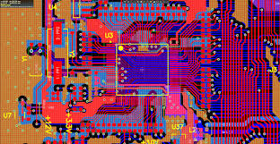

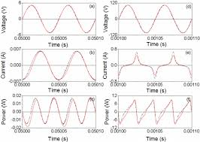
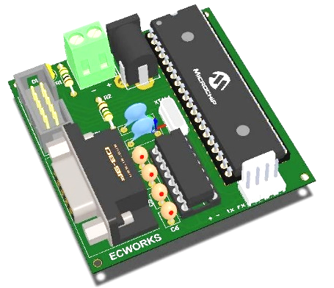
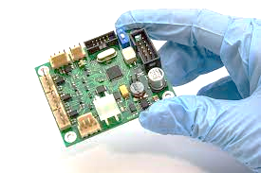
Power Electronic Circuits -
Numerical Simulations
Summer internship Presentation
on
School of Engineering and Sciences (SEAS)
Department of Electronics and Communication Engineering
SRM University, Andhra Pradesh (SRM AP)
Presented by
Jagadeesh_(AP2312210002)
M.Tech _ IOT Student

Slide 2


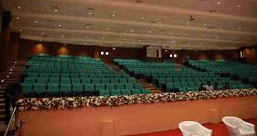



INDIAN INSTITUTE OF TECHNOLOGY PALAKKAD
KERALA

Slide 3

Outline
Abstract
Introduction
Objectives
Methodology
Core work case study
Library / Components
Software Tools
Conclusion and Future scope
Referred Paper
Problem Statement
Present Technology
Proposed Technology
Implementation experimental works

Slide 4

Abstract
Importance: Power electronics are in everything from power supplies to renewable energy
systems.
Numerical Simulation: Crucial for design, analysis, and optimization of these circuits.
Key Aspects Covered:
Fundamentals (switching devices, converter types, control strategies)
Modeling and simulation techniques for accurate behavior prediction
Challenges and Limitations Addressed
Future Trends and Research Directions Explored
Target Audience: Researchers, engineers, and students in power electronics

Slide 5
Introduction
Definition of Power Electronics: Power electronics involves the conversion and control of electrical power using electronic devices.
Importance: It plays a crucial role in enhancing energy efficiency and enabling renewable energy applications.
Applications: Used in various fields, including consumer electronics, electric vehicles, and industrial automation.
Numerical Simulations: Numerical simulations help analyze and validate the performance of power electronic circuits.
Key Components: Common circuits include converters like Buck, Boost, and Buck-Boost converters.
Project Goal: The project focuses on designing and simulating power electronic circuits to improve understanding and application.

Slide 6
Objective
Design and Analyze Power Electronics Converters: Develop and evaluate various power electronic converter topologies, including buck, boost, buck-boost, flyback, forward, and push-pull converters.
Conduct Numerical Calculations: Perform numerical analyses and calculations for the efficiency and performance of different converter configurations.
Create Comprehensive Spreadsheets: Develop a formula-based spreadsheet to facilitate converter calculations and streamline the design process.
Simulate Circuits Using LT Spice: Validate designs and calculations through simulation in LT Spice to ensure accuracy and reliability.
Design Gate Driver Circuits: Create and implement the NCP51820 gate driver circuit to control GaN MOSFETs effectively.
Develop Schematic and PCB Designs: Utilize Altium for detailed schematic creation and PCB layout to integrate the designed circuits into practical applications.

Slide 7

Methodology
Literature Review
Conduct a thorough review of existing literature on power electronics and numerical simulation techniques to establish a foundational understanding of the subject.
Software Setup
Install and configure simulation software such as LTspice for circuit simulation and Altium Designer for PCB design, ensuring all necessary libraries and components are available.
Circuit Design
Design various power electronic circuits (e.g., Buck, Boost, Buck-Boost, Flyback, Forward, and Push-Pull converters) using theoretical principles and simulation tools.
Numerical Simulations
Perform numerical simulations of the designed circuits in LTspice, analyzing parameters such as voltage, current, and efficiency under different operating conditions.
MOSFET & Gate Driver Design
Develop and simulate gate driver circuits, specifically the NCP51820, to control GaN MOSFETs effectively, ensuring proper operation within the designed circuits.
Validation and Testing
Validate simulation results through comparison with theoretical calculations and perform boundary tests to assess the performance of the circuits under various input conditions.

Slide 8
IMPLEMENTATION APPROACHES
Circuit Design
Numerical Simulations
Gate Driver Design
Component Creation
PCB Layout
Spreadsheet Development
Validation and Testing

Slide 9
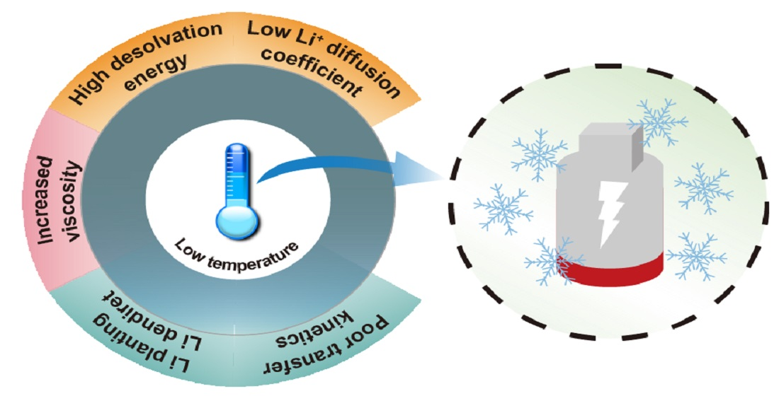


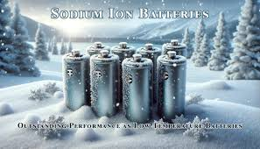
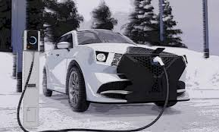

Problem statement
Life span and Internal battery pack issues in subzero temperature conditions
Efficiency Durability Heating Performance
Power Reduced Range Slow Charging
Problem

Slide 10

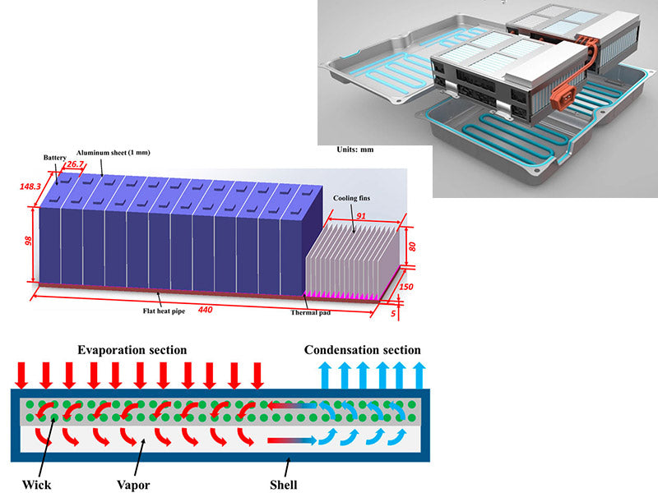
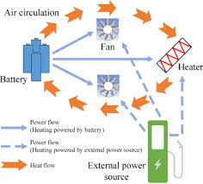
Present Technology
Coil-based heating technology for EV battery preheating utilizes inductive heating coils to efficiently warm batteries, enhancing performance and reliability in cold climates.
Method: Induction Heating
Advantages:
Targeted: Heats specific areas
Uniform: Consistent heating distribution (potential)
Controllable: Precise temperature control
Disadvantages:
Complexity: Requires complex control systems
Efficiency: Energy losses in conversion
Bulk: Coils and electronics add weight/size
To heat the coil, the energy source is from the same battery pack only – so, There is more energy lose in the battery

Slide 11
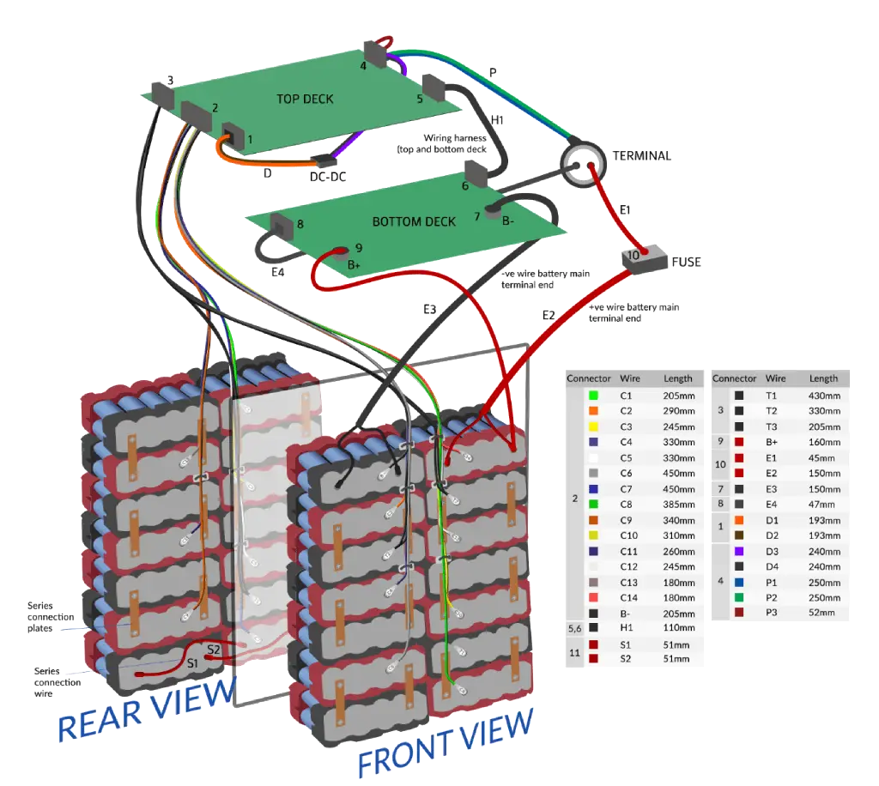
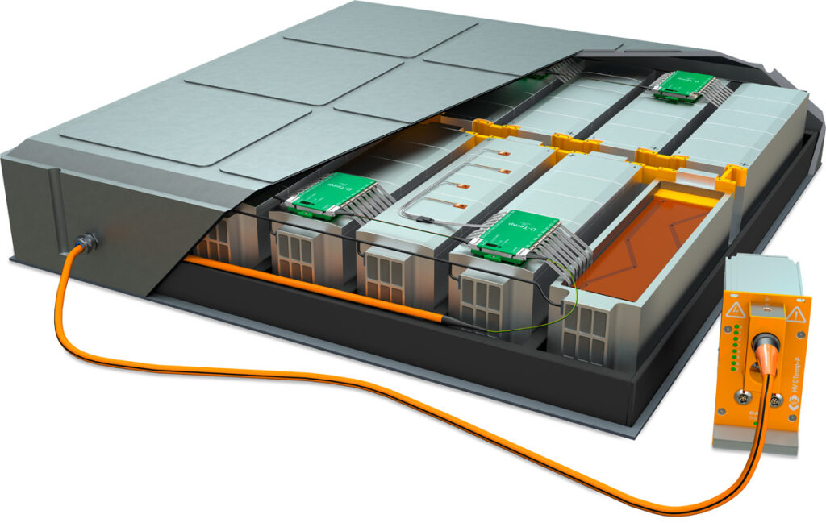
Proposed Technology
Compact and efficient GaN-based battery pre-heater module for improving Battery banks performance in subzero climates.
Enhanced Battery Performance Compact Design Energy Efficiency
Rapid Heating Capability Reliability in Extreme Conditions
Add on
GaN Based DC – DC Converter
Task is to Design a Converter for prototype

Slide 12
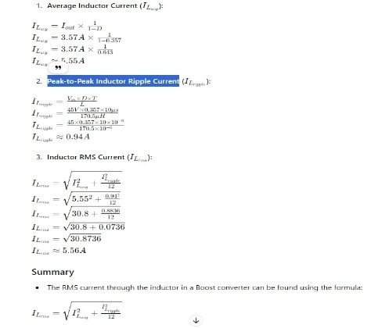
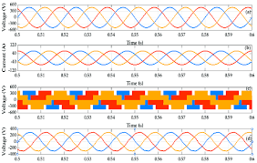
Proposed implementation
Numerical calculation
For every DC converter
Creating Formula based spreadsheet
To reduce the calculation time
LT spice Circuits Simulation
Validating Numerical calculation Wave forms
Converters Calculated
Buck
Boost
Buck – Boost
Forword
Flyback
Push - pull
Synchronous Buck converter

Slide 13
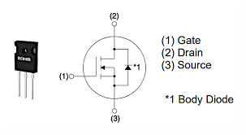


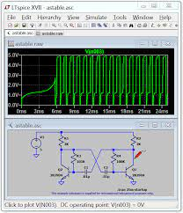
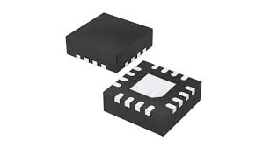
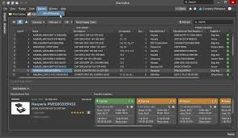
Components created
GaN based MOSFET
MPN - GaN3R2-100CBE
Manufacture - Nexperia
Gate Driver
MPN - NCP51820
Manufacture – On semi
GAN3R2-100CBE
https://assets.nexperia.com/documents/data-sheet/GAN3R2-100CBE.pdf
High Speed Half-Bridge Driver for GaN Power Switches NCP51820
www.onsemi.com/pdf/datasheet/ncp51820-d.pdf
Bill of Materials

Slide 14

NCP51820 Gate Driver
High-Speed Performance: The NCP51820 is designed for fast switching applications, making it suitable for driving GaN and SiC power switches efficiently.
Half-Bridge Configuration: It supports a half-bridge configuration, allowing for effective control of power converters in various applications.
Integrated Protection Features: The driver includes built-in protection features such as under-voltage lockout and shoot-through protection to enhance reliability.
Flexible Supply Voltage: It operates with a wide supply voltage range, accommodating different system requirements and enhancing versatility.
Compact Design: The NCP51820 comes in a compact package, making it ideal for space-constrained applications in power electronics.
GaN3R2-100CBE MOSFET
High Efficiency: The GaN3R2-100CBE MOSFET offers superior efficiency in power conversion applications due to its low on-resistance and fast switching capabilities.
High Voltage Rating: This MOSFET is rated for high voltage applications, making it suitable for use in demanding environments such as electric vehicles and renewable energy systems.
Compact Size: Its compact packaging allows for space-saving designs in power electronics, contributing to lighter and more efficient systems.
Thermal Performance: The GaN3R2-100CBE provides excellent thermal performance, enabling reliable operation under high-temperature conditions.

Slide 15
Tools and Software’s
LT Spice
Powerful Simulation Tool: LT Spice is a free SPICE simulator that allows for fast and efficient circuit simulation, particularly suited for power electronics.
Extensive Model Library: It includes a comprehensive library of over 1,100 macromodels and passive devices, facilitating circuit design and analysis.
Optimized for Power Electronics: LT Spice is ideal for simulating switching mode power supplies (SMPS), offering features like steady-state detection and efficiency calculations.
Altium PCB Design
All-in-One Design Software: Altium Designer integrates schematic capture, PCB layout, and manufacturing documentation into a single interface for streamlined design processes.
3D Visualization: It provides advanced 3D visualization of PCB assemblies, allowing designers to view and verify layouts before production.
Collaboration Features: Altium 365 enables seamless collaboration among team members, facilitating co-design and efficient resource management across locations.

Slide 16
Conclusion
Power electronic converters, such as buck, boost, and flyback, are crucial in modern electrical engineering.
They efficiently manage and convert electrical power across various applications, improving energy
efficiency and reducing power losses. Buck converters step down voltages, boost converters step up
voltages, and buck-boost converters can do both. Flyback converters allow multiple output voltages from a
single input, and forward converters are suitable for high output currents. The choice of converter depends
on the application's requirements, and careful selection is essential for optimal performance and energy
efficiency.

Slide 17
Referred Paper
Fundamentals of MOSFET and IGBT Gate Driver Circuits
www.ti.com/lit/ml/slua618a/slua618a.pdf?ts=1719894189069&ref_url=https%253A%252F%252Fwww.google.com%252F
GAN3R2-100CBE
https://assets.nexperia.com/documents/data-sheet/GAN3R2-100CBE.pdf
High Speed Half-Bridge Driver for GaN Power Switches NCP51820
www.onsemi.com/pdf/datasheet/ncp51820-d.pdf

Slide 18


Thankyou
Naga Brahmendra Yadav Gorla
Assistant Professor
Department of Electrical Engineering
IIT - Palakkad
Thanks to SRM University AP,
ECE – Department

